Slide 1

Sea Exploration System
This presentation explores the design and implementation of a data structures and algorithms project simulating a sea exploration adventure.
By Hashir Naan Nizazi 2023430

Slide 2
Introduction: The Sea Exploration System
Objective
Key Features
Explore islands, manage resources, and navigate paths using graph-based algorithms.
Add islands and connect them with paths.
Explore and choose routes based on resources.
Find the shortest path between islands.
Sort islands by resources.
Track visited islands.

Slide 3
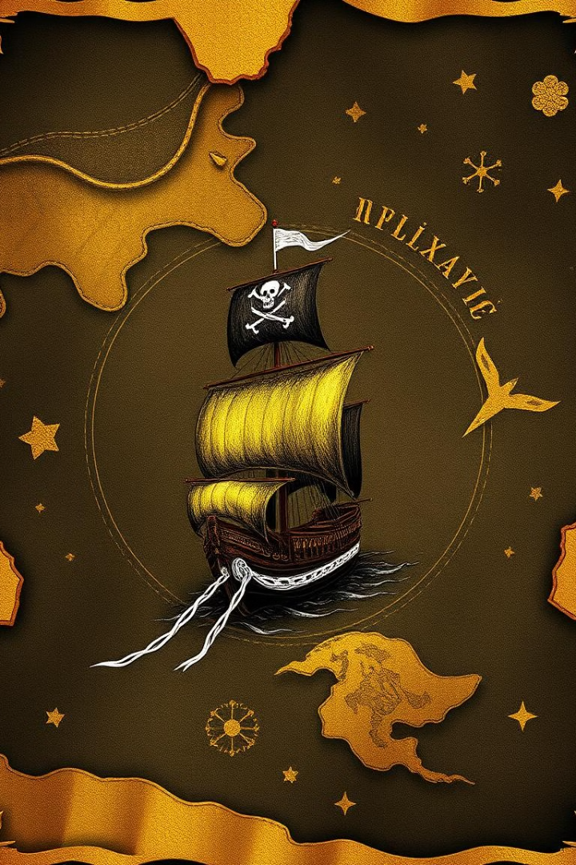
Why This Project?
1
Applying Graph Algorithms
2
Hands-on Implementation
Interactive way to apply graph algorithms and data structures.
Experience with graphs, Dijkstra's algorithm, stacks, and linked lists.
3
Real-world Simulation
Combine programming with problem-solving in a sea exploration scenario.

Slide 4
System Architecture: How It Works
Graph Representation
Key Algorithms
Islands are nodes, travel paths are edges with costs.
Dijkstra's Algorithm: shortest paths.
Merge Sort: sorting islands by resources.

Slide 5
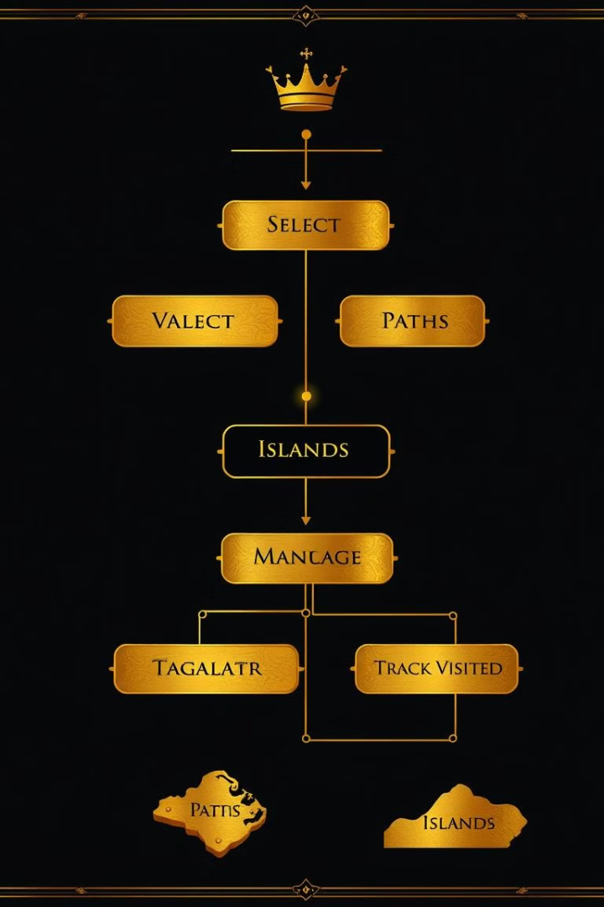
Exploring the Sea: Core Feature
1
Exploration System
2
Helper Stack
Move between islands, deduct costs, gain resources, and track visited islands.
Tracks visited islands, enhancing the gameplay experience.

Slide 6
Sorting Resources: Merge Sort Implementation
Sorting by Resources
Data Structure
Islands are sorted for analysis and resource management.
Linked list implementation for dynamic storage of island data.

Slide 7
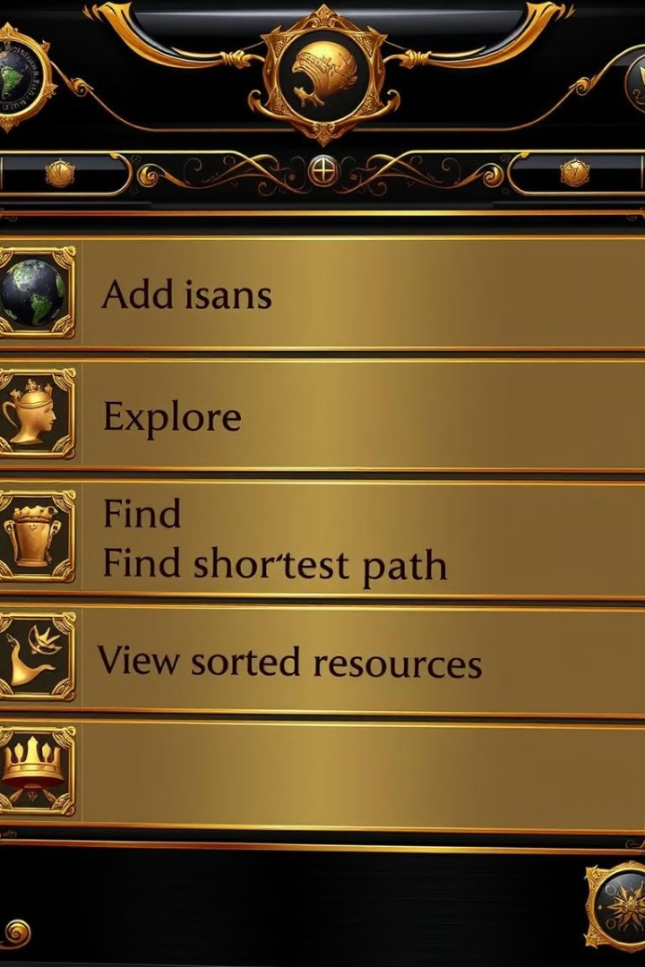
Menu System: User Interaction
1
User Interaction
2
Menu System
Add islands, explore, find shortest paths, and view sorted resources.
Provides a clear and intuitive way for users to interact with the program.

Slide 8
Challenges & Learnings: The Journey
Challenges
Learnings
Designing graph traversal logic.
Hands-on graph-based problem-solving.
Implementing Dijkstra's algorithm and custom data structures.
Efficient resource utilization.
Applying theoretical knowledge to a practical project.

Slide 9

Conclusion: A Fun Exploration of Algorithms
1
Program Functionality
2
Key Takeaways
The Sea Exploration System provides a fun and engaging way to explore algorithms and data structures.
Combining creativity with core computer science concepts.

Slide 10
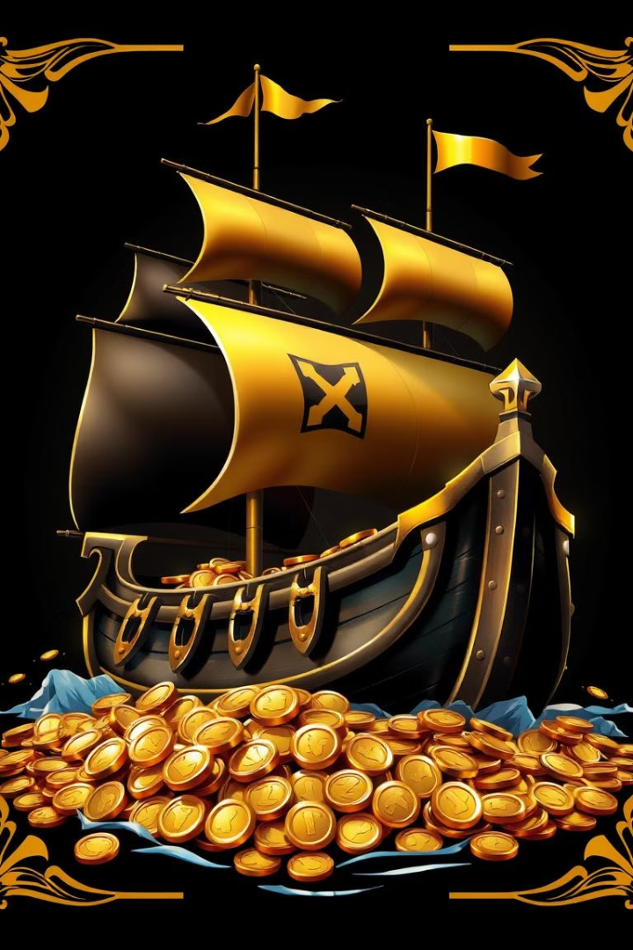
Thank You
Thank you for your time. Let me know if you have any questions or would like to see a demonstration of the system.

